Slide 1

Chapter 3 Data Modeling using the Entity Relationship (ER) Model

Slide 2
Road Map
High Level Conceptual Model for DB Design
Sample DB Application
Entity Types, Entity Sets, Attributes & Keys
Relationship Types, Sets, Roles & Constraints
Weak Entity Types

Slide 3
Road Map…
ER Design for the Company Database
Diagram, Naming Conventions & Design
Relationship Types of Degree Higher than Two

Slide 4
High Level Conceptual Model for DB Design

Slide 5
Steps for Preparing Conceptual Model
Step 1: Gather & Collect Requirements
Collect Functional Requirements
Operations, Transactions
Can also be specified using DFDs, Sequence Diagrams & Scenarios
Collect Data Requirements
Data semantics etc…

Slide 6
Steps for Preparing Conceptual Model
Step 2: Make Conceptual Design of the DB
Make use of some Conceptual Model to prepare the App’s Conceptual Schema
It should fully reflect the User Requirements
Diagrammatically present:
Entities & their Relationships
Constraints
Must “not” include implementation details

Slide 7
Steps for Preparing Conceptual Model
Step 3: Implement the DB
converting high-level Data Model to Implementation Data Model
called “Logical Design” or “Data Model” Mapping
results in DB Schema in the Implementation Data Model
Implementation (automated or semi-automated) within the DB Design tool
Selection of Commercial DBMS for implementation

Slide 8
Steps for Preparing Conceptual Model
Step 4: Physical Design Phase
Specification of:
the internal design structure,
file organizations,
indexes etc.
In parallel, Application Programs are designed to utilize the DB

Slide 9
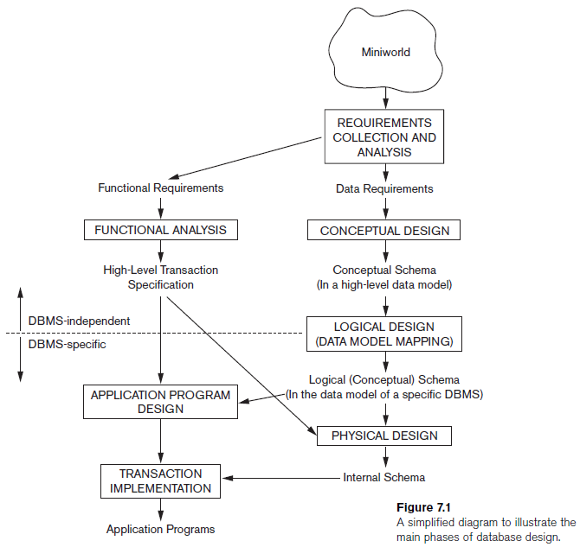
Steps for Preparing Conceptual Model

Slide 10
Case study: A Sample DB Application…

Slide 11
Company Database
We have to keep track of company’s Employees, Departments & Projects
Each Department has a unique number, name and a particular Manager
Department may have several locations
Department controls a number of Projects.
Each Project has a unique number, name and a single Location
We store each Employee’s Name, SSN, address, salary, gender and DOB
An Employee belongs to one Department but can work on several Projects which are not necessarily maintained by one Department
We keep track of current number of hours per week that an Employee works on each project
We also keep track of direct Supervisor of each Employee
We will keep track of Dependents of each Employee for insurance purposes
We will keep track of Dependent’s First Name, Gender, DOB and relationship to the Employee

Slide 12
ER Model CONCEPTS: Entity, Attribute & Key

Slide 13
Entity
Any real-world object about which we want to keep information is an “Entity”. OR
“Entity” is some independent object with existence in the real-world …
Each Entity has “Attribute(s)” that describe it’s characteristics or properties
Normally an Entity holds value for all of it’s attributes…

Slide 14
Entity
Employee’s Name: Aslam Talal with Employee ID: Emp1; NIC: 61105-1111201-1; address: H.No. 12, Street 84, Sector F-6/1; Islamabad; Gender: Male and DOB: 4/8/1989 is an Entity
Attributes for Employee are:
Employee’s Name, SSN, address, salary, gender and DOB

Slide 15
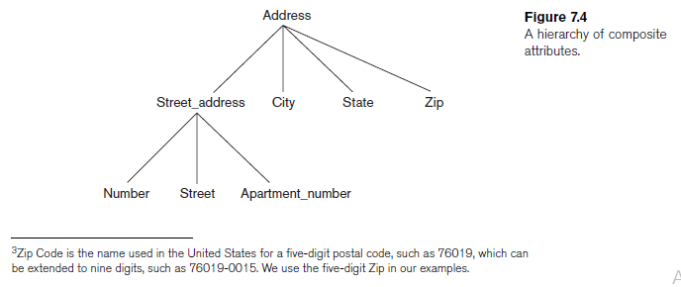
Types of Attributes
“Composite Attribute” can be divided in smaller sub-parts that can form a hierarchy
“Simple or Atomic Attributes” are not divisible

Slide 16
Types of Attributes
Single-Valued Attribute can only attain one single value for an entity e.g. Age
Miltivalued Attribute can attain multiple values for an entity e.g. College Degrees
Some attributes can determine value of another attribute. For example, in the case of DOB and Age, Age can be derivable from DOB. Hence,
Age is the “Derived Attribute” and
DOB is the “Stored Attribute”

Slide 17
Value Sets (Domain) of Attributes
Every Attribute has a domain
“Value Set: for the Name attribute can be a set of strings of alphabetic characters separated by blank characters, and so on…
Value sets are not displayed in ERD and are typically specified using the basic data types such as integer, string, Boolean etc…

Slide 18
Value Sets (Domain) of Attributes
Mathematically, an attribute A of entity set E whose value set is V can be defined as function from E to the power set P(V)
A : E → P(V)
value of attribute A for entity e as A(e)
NULL value is represented by the empty set.
For a composite attribute A, the value set V is the power set of the Cartesian product of P(V1), P(V2), ..., P(Vn), where V1, V2, ..., Vn are the value sets of the simple component attributes that form A:
V = P (P(V1) × P(V2) × ... × P(Vn))
The value set provides all possible values. Usually only a small number of these values exist in the database at a particular time.

Slide 19
More on Entities …
“Entity” is something which has real existence
“Entity Type” is collection of entities having common attribute
“Entity Set” is a set of entities of same entity type. It is a subset of Entity Type.
“Entity Type” describes the “schema” or “intention” and the complete “Entity Set” describes “extension” of the schema
If an “Entity Type” has no “Key”; it is called “Weak Entity Type”

Slide 20
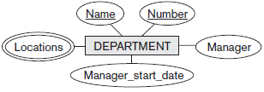
Initial Conceptual Design of Company DB
Each Department has a unique number, name and a particular Manager
Department may have several locations
Entity Type: DEPARTMENT
Attributes: Number, Name, Manager
Key Attribute(s): Number, Name
Multivalued Attribute(s): Location

Slide 21
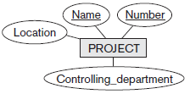
Initial Conceptual Design of Company DB
Department controls a number of Projects.
Each Project has a unique number, name and a single Location
Entity Type: PROJECT
Attributes: Number, Name, Location, Controlling Department
Key Attribute(s): Number, Name

Slide 22
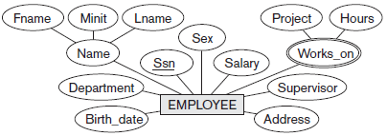
Initial Conceptual Design of Company DB
We store each Employee’s Name, SSN, address, salary, gender and DOB
An Employee belongs to one Department but can work on several Projects which are not necessarily maintained by one Department
We keep track of current number of hours per week that an Employee works on each project
We also keep track of direct Supervisor of each Employee
Entity Type: EMPLOYEE
Attributes: Name, SSN, address, salary, gender and DOB, Department, Supervisor
Key Attribute(s): SSN
Composite Attribute(s): Name, Address

Slide 23

Initial Conceptual Design of Company DB
We will keep track of Dependents of each Employee for insurance purposes
We will keep track of Dependent’s First Name, Gender, DOB and relationship to the Employee
Entity Type: DEPENDANT
Attributes: Employee, Dependent_Name, Gender, DOB, Relationship (to the Employee)
Composite Attribute(s): Name, Address

Slide 24
Relationship Types, Relationship SETS, Roles & STRUCTURAL CONSTRAINTS

Slide 25
Relationship Types, Sets & Instances
“Relationship” is an association among several entities
For example:
an Attribute of one Entity Type refers to another Entity Type. This reference is “Relationship”
For example: “Depart Name” in “Employee “Entity Type refers to “Department “Entity Type
“Relationship Type” R among n Entity Types E₁, E₂, …, E_{n} defines a set of associations among entities from these Entity Types.
Relationship Set is a Set of associations of the same Type.
Set of Relationship Instances r_{i}
Each r_{i} associates n individual entities (e₁, e₂, …, e_{n} )
Each entity e_{j} is a member of Entity Set E_{j}

Slide 26
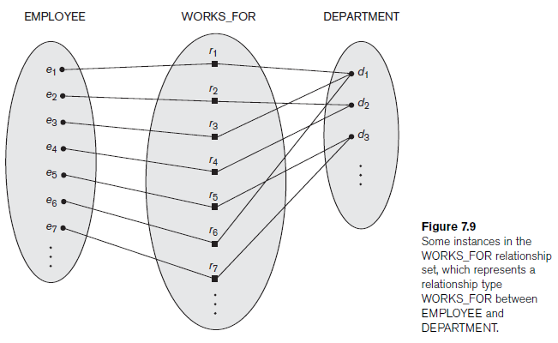
Relationship Types, Sets & Instances
Each “Relationship Instance” (r₁, r₂, …, r_{n} ) links entities of type EMPLOYEE to entities of type DEPARTMENT

Slide 27

Relationship Types, Sets & Instances
The relationship name is displayed in the diamond-shaped box
In ER diagrams, Relationship Types are displayed as diamond-shaped boxes, which are connected by straight lines to the rectangular boxes representing the participating Entity Types.
Relationship Types are useful for capturing/ expressing certain business rules

Slide 28
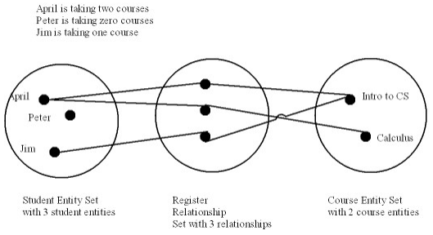
Relationship Types, Sets & Instances
Relationship Set is a collection of relationships all belonging to one relationship type.

Slide 29
Degree of Relationship Type
The degree of a relationship type is the number of participating entity types.
Works_For relationship is binary
it is also called a relationship of degree two
Relationship of degree three is called ternary
Example: Some Supplier “s” supplies Part p for the Project j Here, each relationship instance r_{i} associates three entities—a supplier s, a part p, and a project j

Slide 30
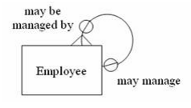
Recursive Relationship
Relationship always appear between occurrences in two different entities.
It is possible for the “same entity” to participate in the relationship. This is termed as ”Recursive Relationship”
Example: EMPLOYEE manages many Employees.

Slide 31
Constraints on Binary Relationship Type
Constraints limit the possible combinations of entities that participate in the corresponding relationship set.
Types of constraints on Binary Relationship
Cardinality Ratio
Participation Constraint
The above two constraints are also called the “Structural Constraints” of a relationship type

Slide 32
Cardinality Ratio Constraint
Cardinality Ratio for a Binary Relationship specifies the Maximum Number of relationship instances that one entity can participate in
There are three types of Cardinality Ratios

Slide 33
Cardinality Ratio Constraint
There are three types of Cardinality Ratios
One Department can have one HOD. This binary relationship is of cardinality ratio 1:1
In WORKS_FOR binary relationship; DEPARTMENT:EMPLOYEE is of cardinality ratio 1:N
Students can enroll for many subjects. A subject is enrolled by many Students; is a relationship of cardinality M:N

Slide 34
Participation Constraint
Participation Constraint for a Binary Relationship specifies the Minimum Number of relationship instances that one entity can participate in
Also called “Minimum Cardinality Constraint”
There are two types of Participation Constraints
Total Participation
Partial Participation

Slide 35
Participation Constraint
Total Participation
If a company policy states that an Employee must work for a Department, then an employee can exist iff it participates in at least one WORKS_FOR relationship
Total participation is also called “existence dependency”
It means a minimum of 1 and is represented by double line
Partial Participation
Every employee cannot manage a department. So the participation of EMPLOYEE in the MANAGES relationship type is partial since all employees cannot be Managers
It means a minimum of 0 and is represented by single line

Slide 36
Attributes of Relationship Types
Relationship Types may also have attributes…
Case 1: Binary + 1:1
HOD Manages a Department. In this case, Date_of_Joining is the Relationship Type Attribute. It can be accommodated in any of the two entities…
Case 2: Binary + 1:N
Student gets Registered in a Department. In this case, Date_of_Registration is the Relationship Type Attribute. It should be adjusted to Many side…
Case 3: Binary + M:N
Student registers many Subjects. In this case, Date_of_Registration is the Relationship Type Attribute. It should be adjusted to Many side…

Slide 37
Weak Entity Types

Slide 38
Weak Entity Types Overview
“Weak Entity” is an Entity Type that does not have the “Key” Attribute of their own
“Strong Entity Types” are the regular entity types that have a key attribute
“identifying relationship” exists between the Weak Entity Type and it’s “Owner Entity Type”

Slide 39
Weak Entity Types Overview
“Total Participation Constraint” OR “Existence Dependency” always exists between the Weak Entity Type and it’s “Owner Entity Type” because a weak entity cannot be identified without an owner entity.
Not every existence dependency results in a weak entity type.
Example: DRIVER_LICENSE entity cannot exist unless it is related to a PERSON entity even though it has its own key (License_number) thus it is not a weak entity.

Slide 40
Weak Entity Types Overview
“partial key” attribute can uniquely identify weak entities that are related to the same owner entity.
In ER diagrams, Weak Entity Type and its identifying relationship are distinguished by surrounding their boxes and diamonds with double lines
The partial key attribute is underlined with a dashed or dotted line.

Slide 41
ER Diagrams, Naming Conventions, and Design Issues

Slide 42
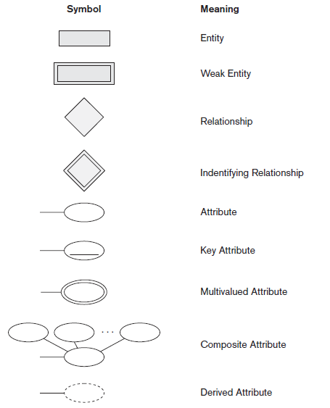
Notations of ER Diagram
Notes:
42
Inaccurate Estimate
Ineffective Control
Insufficient Tracking
Requirements not fulfilled

Slide 43
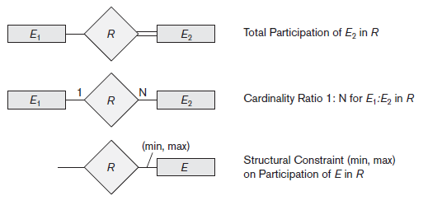
Notations of ER Diagram
Notes:
43
Inaccurate Estimate
Ineffective Control
Insufficient Tracking
Requirements not fulfilled

Slide 44
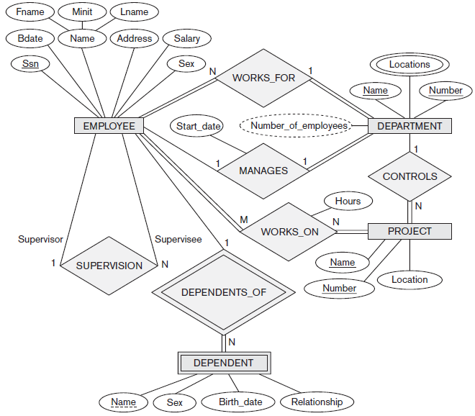
High- Level Conceptual Schema for the Company DB
Notes:
44
Inaccurate Estimate
Ineffective Control
Insufficient Tracking
Requirements not fulfilled

Slide 45
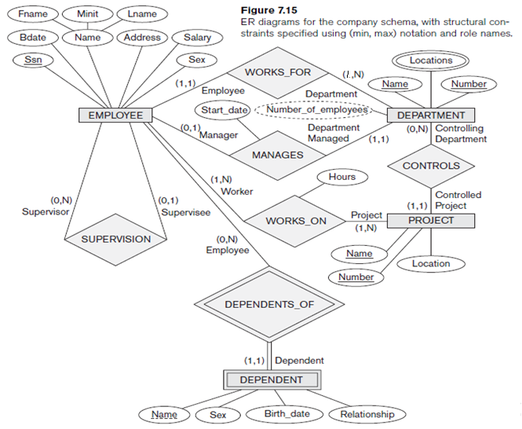
ERD for the Company Schema with Structural Constraints
Notes:
45
Inaccurate Estimate
Ineffective Control
Insufficient Tracking
Requirements not fulfilled

